Slide 1

Room Monitor
John Joey Wright

Slide 2

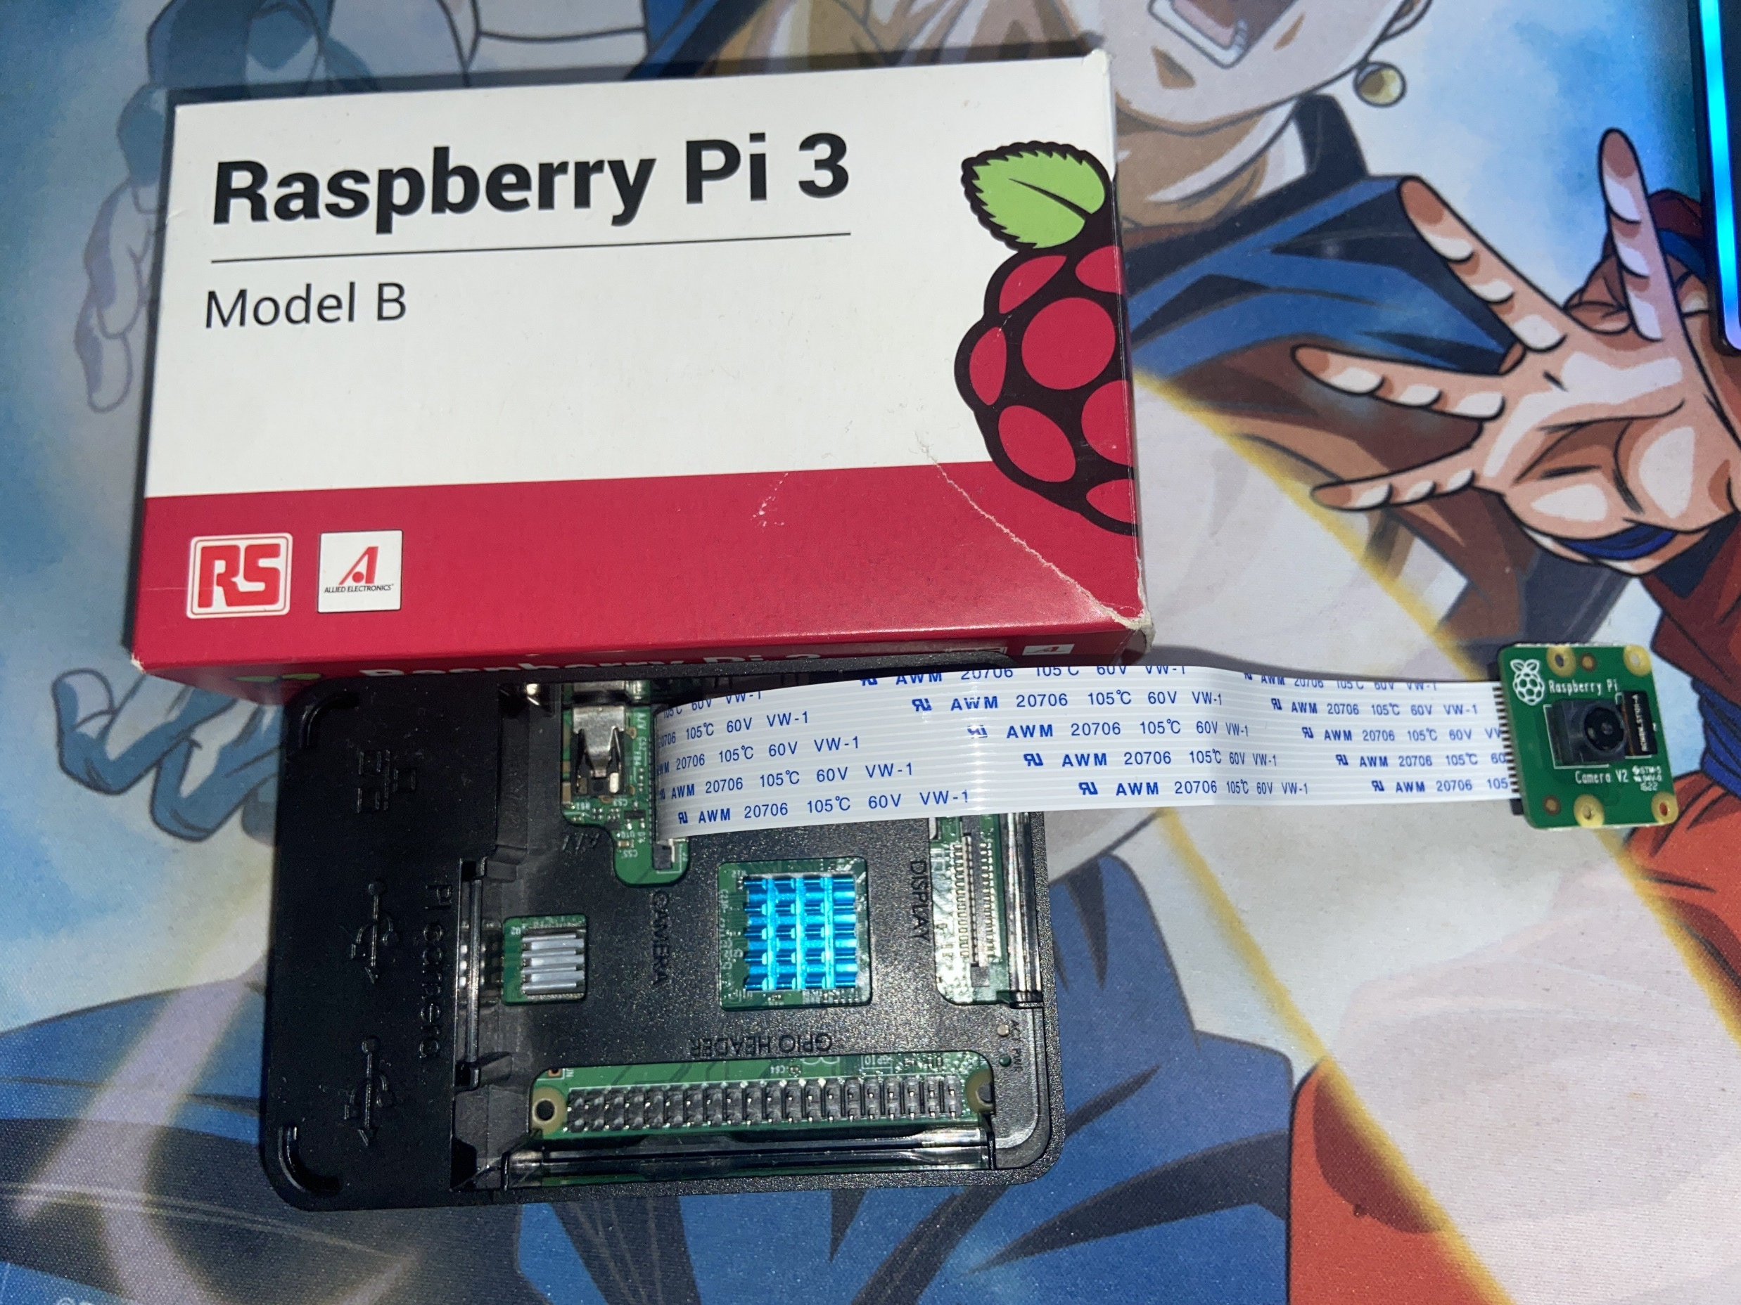
Raspberry Pi
The Raspberry Pi provides the necessary tools for the security camera part of the project, I found tutorials online explaining how to use the raspberry pi camera and how to make local http and a https web server using a service like ngrok.

Slide 3
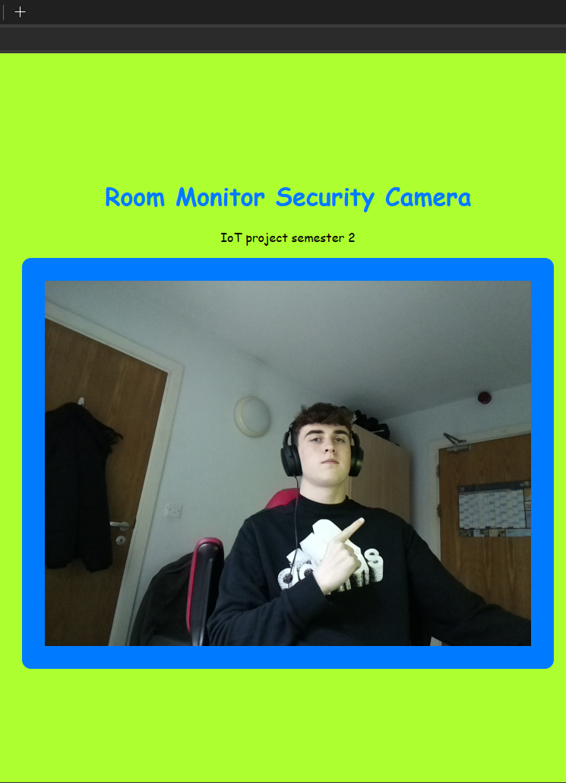
Pi cam website
After I made the Pi cam work with ngrok I wanted to implement it into a website so I made a small webpage using HTML and CSS.
Here is a photo of me testing the security camera.

Slide 4
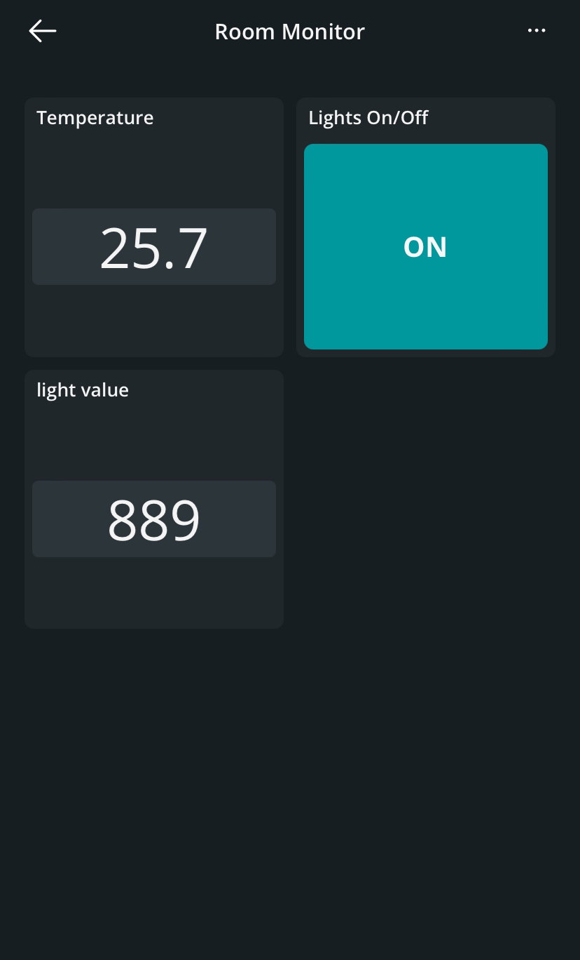
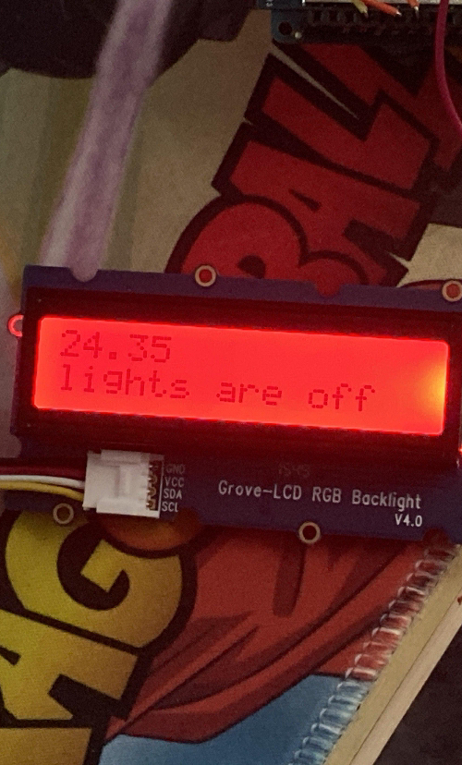
Arduino
The Arduino side of it monitors the rooms light levels and temperature, you can see this from the IoT remote or the Grove-LCD screen.
The colour of the Screen changes with the temperature, blue when its below 20 degrees, green when its 20 degrees and red when it is above 20 degrees.

